Slide 1
Project Professional 2016
Hari Thapliyal

Slide 2
Baseline

Slide 3
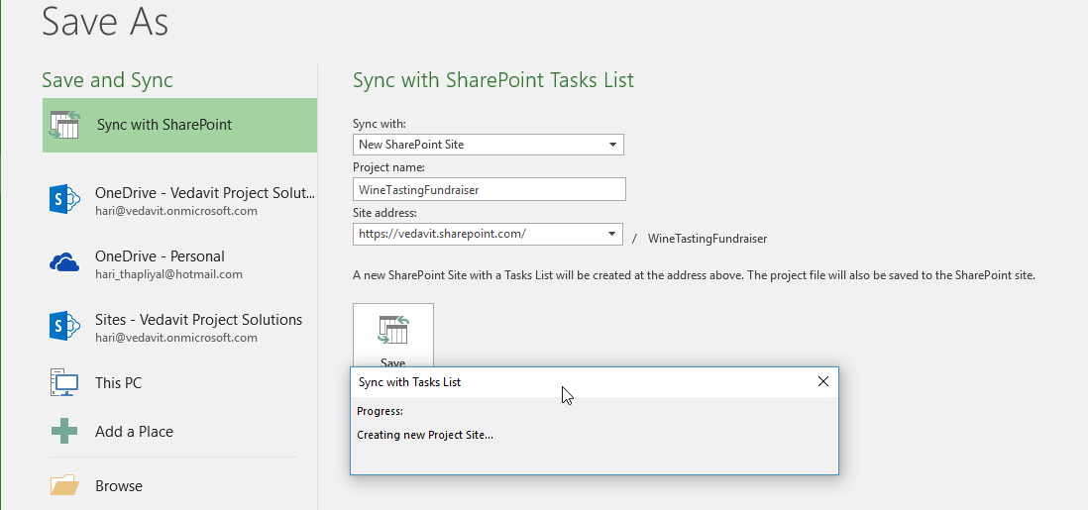
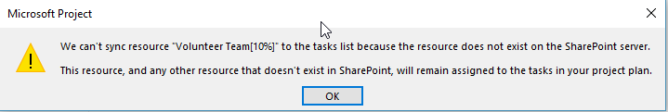
Save Project File to SharePoint Site

Slide 4
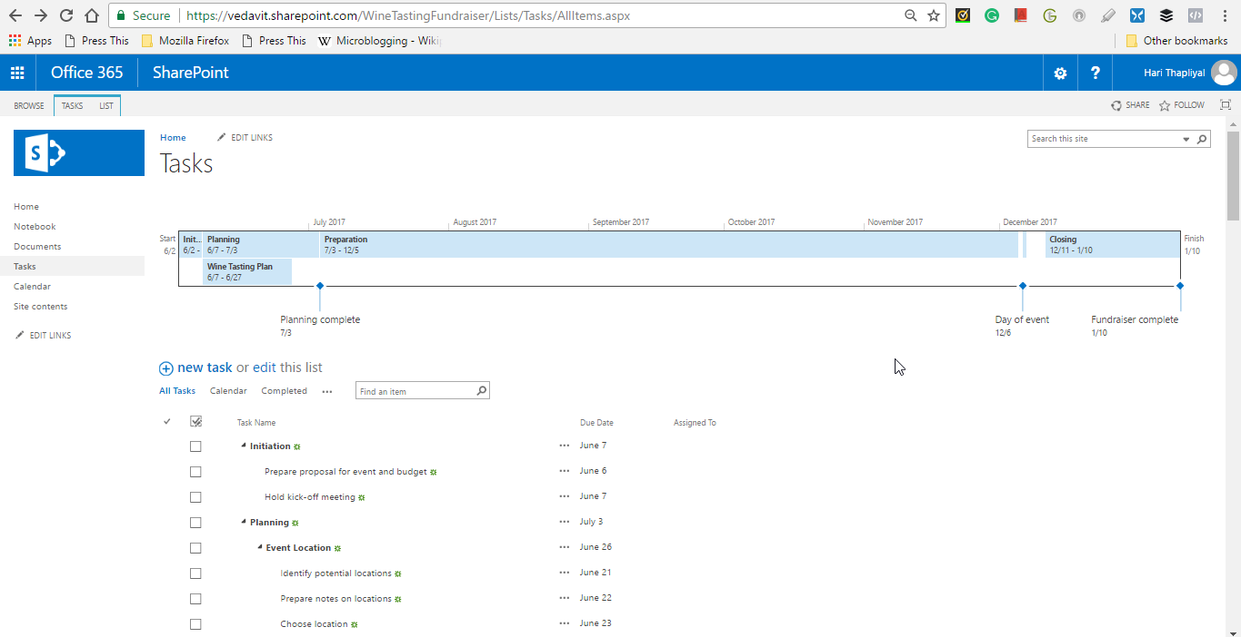
Project Professional – Save Project on Share Point

Slide 5
What is Baseline? Why to Baseline?

Slide 6
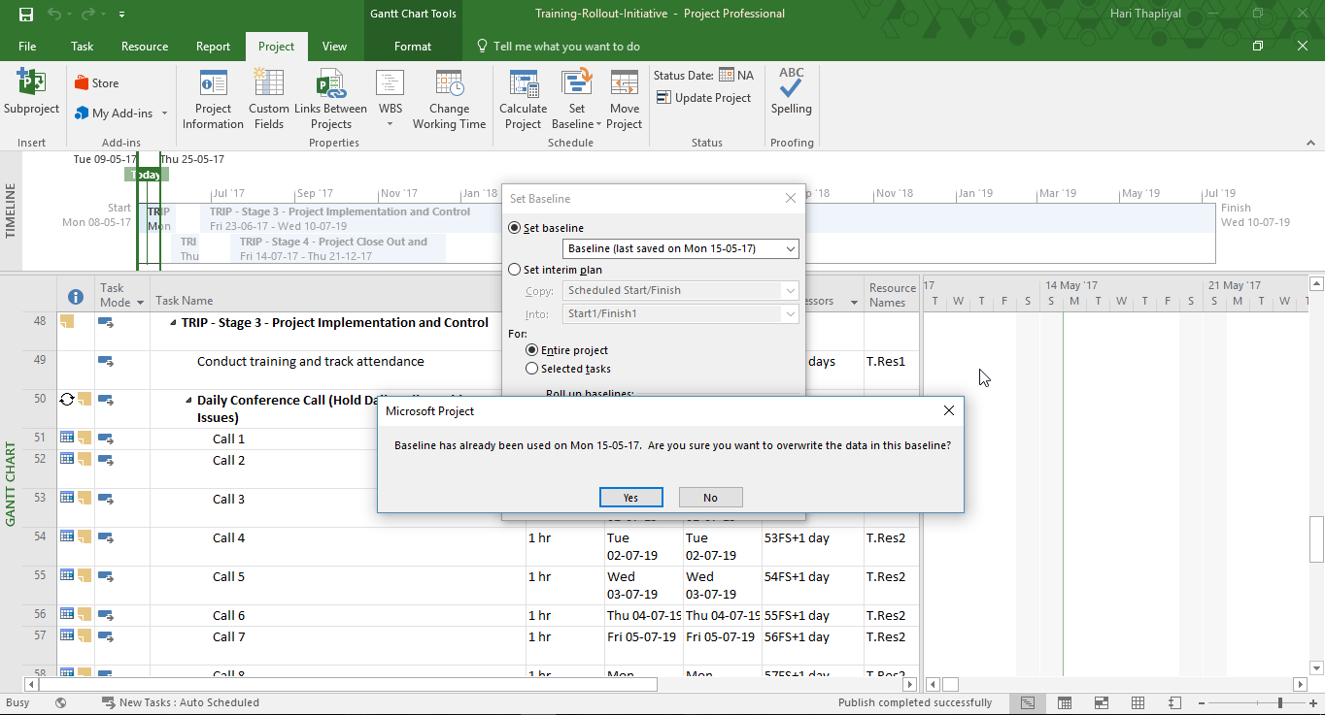
How to Baseline

Slide 7
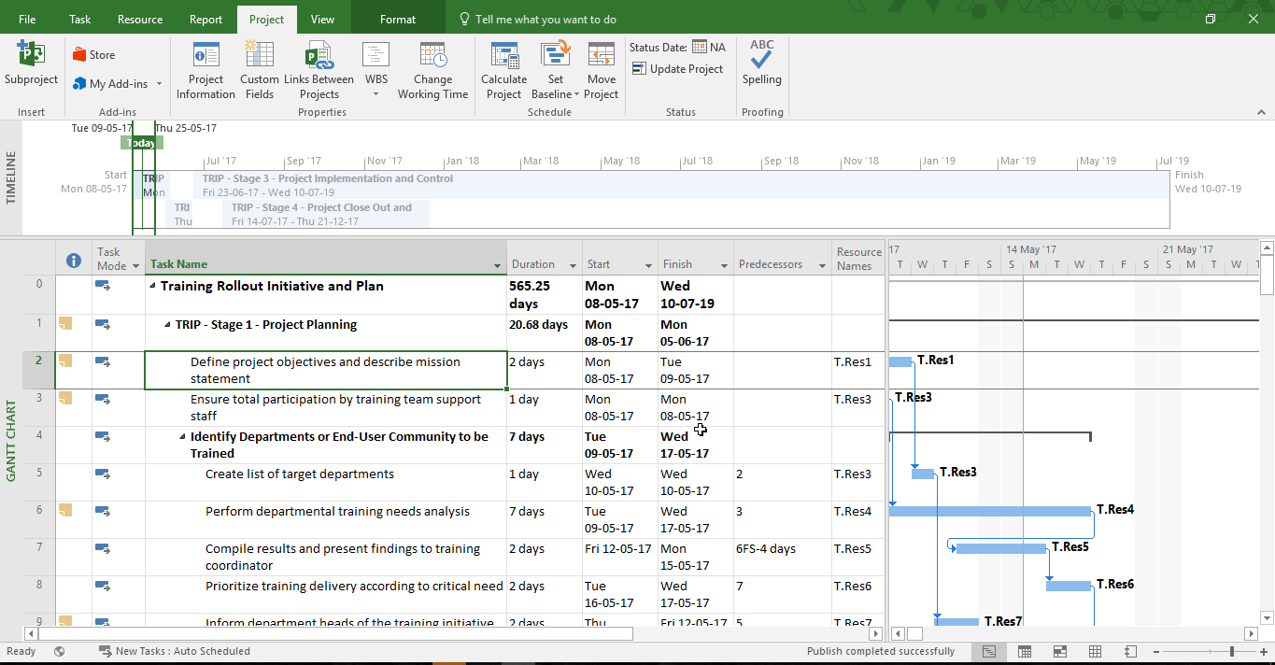
Add to Timeline

Slide 8
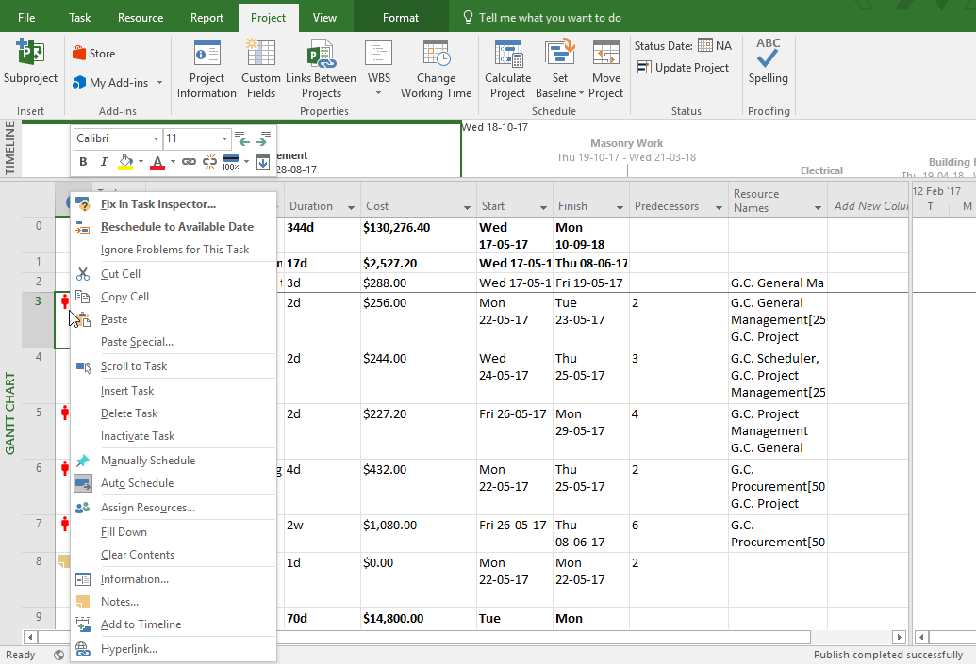
Overloaded Resources

Slide 9
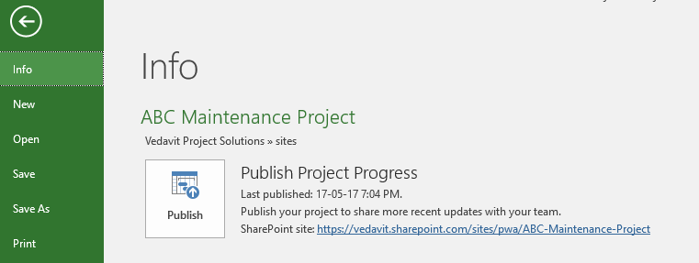
Project Published on Project Online (Project Server)

Slide 10
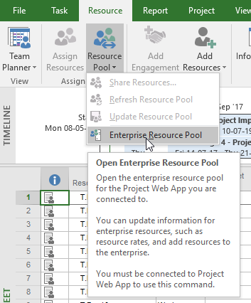
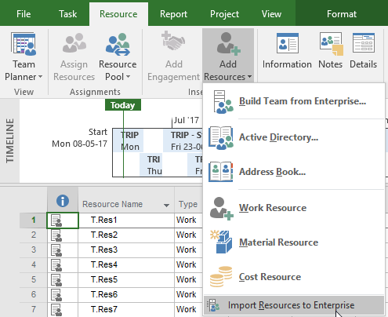
Resource Management

Slide 11
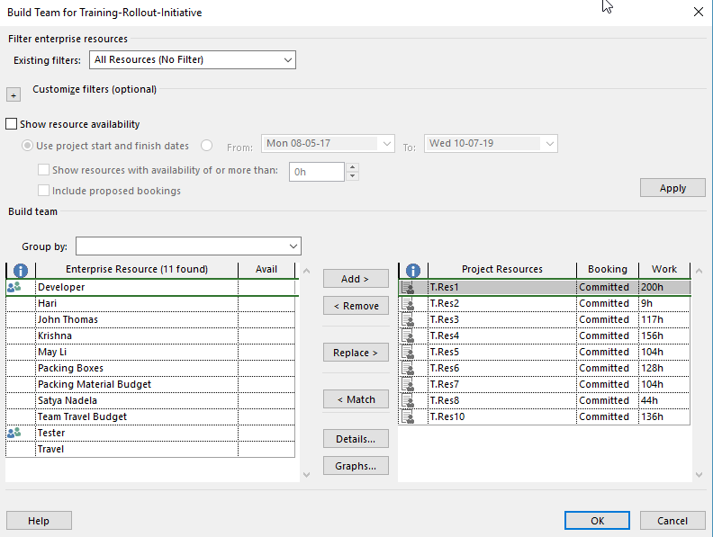
Build Team for Training-Rollout-Initiative
1
2

Slide 12
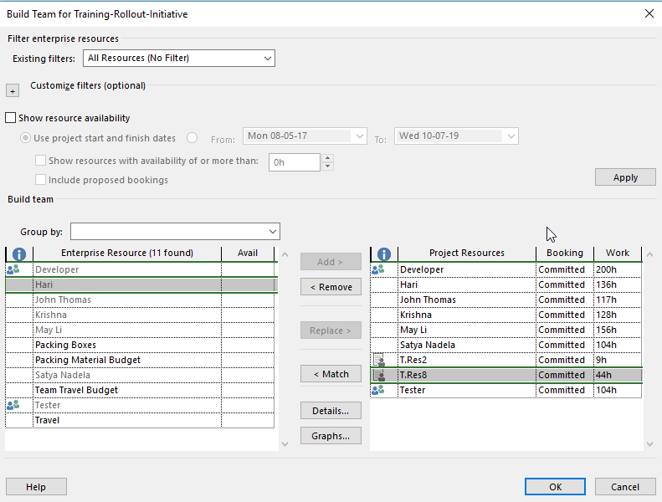
Build Team for Training-Rollout-Initiative

